Slide 1

WattsOn®-Mark II
Meter
TRAINING

Slide 2

Agenda
Power Theory
Current Transformers
WattsOn-Mark II Product Overview
Installation Practices
Meter Configuration
Troubleshooting
  Functionality
  Measurement
Maintenance

Slide 3

Power Theory
We are dealing with AC Power measurements.
Most commercial / industrial power systems are THREE PHASE
To measure power we must measure both Voltage and Current

Slide 4

Power Theory – Voltage & Current
What is “voltage” and “current”?
  Voltage: a measurement of the electrical POTENTIAL. (“Volts”)
  Current: the FLOW of electrons through a conductor. (“Amps”)
  River Analogy: “voltage” would be analogous to the SLOPE (speed) at which the river flows, and “current” to its WIDTH.

Slide 5

Power Theory - Power
What is Power?
  Power: the ABILITY to do WORK
  It is a product of voltage AND current
  P = V * I … (Power = Volts * Amps) … in WATTS
  River Analogy: the rate of flow of water
Fast & Narrow
Wide & Slow

Slide 6

Power Theory - Energy
What is Energy?
  Energy: the amount of POWER delivered over a period of TIME
  E = P * t (Energy = Power * time) ➔ Wh (kWh)
  River Analogy: The amount (volume) of water
  Energy tells us how much POWER was used
  (or produced!) over a period of time.
  Example:
    1kWh = 1000 W for 1 hour
    or
    2000 W for 30 minutes

Slide 7
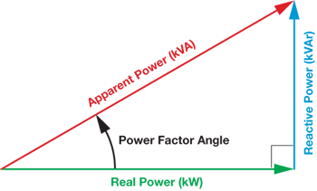

Power Triangle
The relationship between:
  REAL power (kW) – Does actual work (+/-)
  REACTIVE power (kVAR) –moves back and forth
  but does no actual work (+/-)
  APPARENT power (kVA) – Total Power
  in the circuit, combining
  Real & Reactive Power
  (no sign)
  $VA=\sqrt{W^{2}+{VA}^{2} }$

Slide 8
Power Theory – Power Factor
Definition: The ratio of “Real Power” to “Apparent Power”, which indicates the efficiency.
Power factor also specifies the relationship between the voltage and current waveforms. Ie: Current is in phase or leading or lagging Voltage.
-0.0
-0.1
…..
-0.9
1.0
+0.9
…..
+0.1
+0.0
Unity
Leading (Capacitive)
Lagging (Inductive)

Slide 9
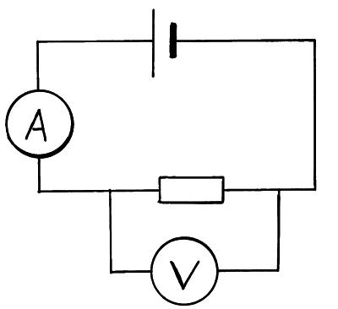
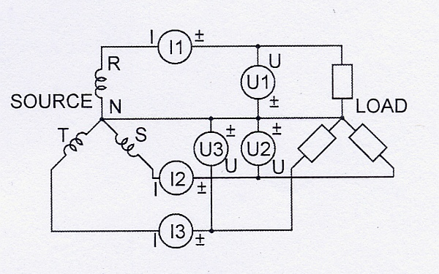
Power & Energy Measurement
Voltage is measured via voltage taps (direct connection)
Current is measured via pickups (Current Transformers) – CTs
  Known as “indirect metering”

Slide 10
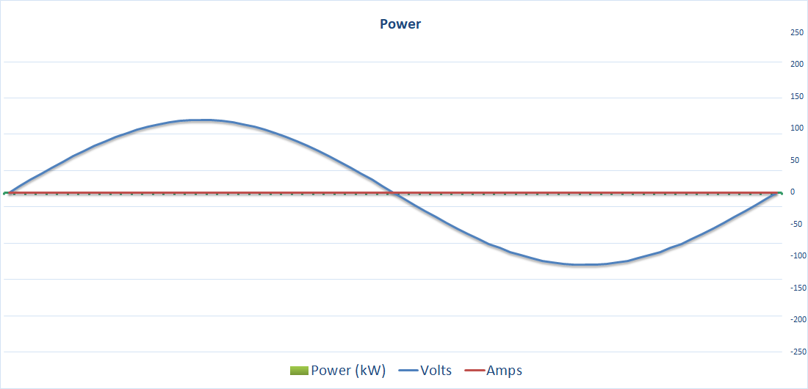
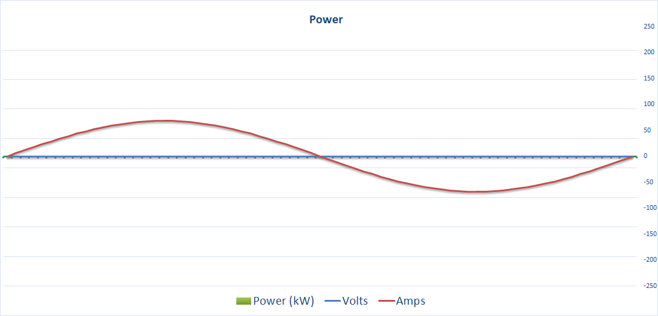
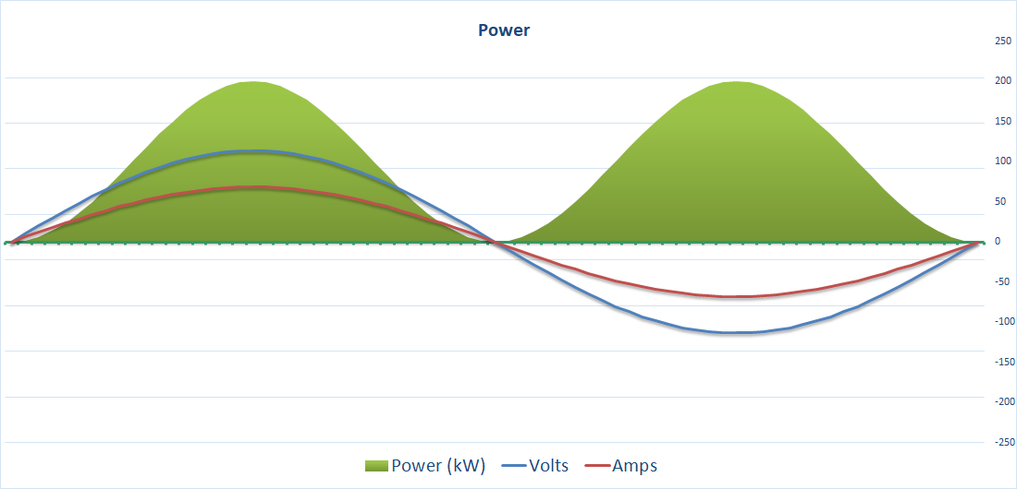
Power & Energy Measurement
POWER is calculated based on the relationship between real time AC voltage and current measurements

Slide 11
DEMO

Slide 12
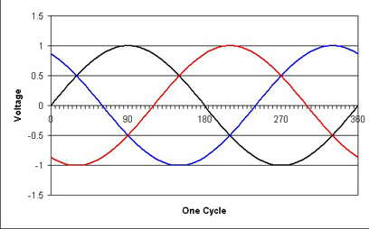
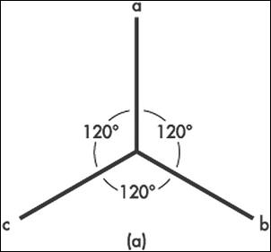
Power Theory – Three Phase
Three phase systems have three distinct circuits.
Three voltages, three currents

Slide 13
Current Transformers
Why are they necessary?
  Signal scaling
  Voltage / Current / Channel isolation
How does it work?
  Output current proportional to input current
  Output waveform represents input waveform
  Non contact, works on magnetic principle
  A CT is a CURRENT SOURCE
    Ideally a CT likes to be SHORTED, therefore low resistance (impedance) is preferred for best performance.

Slide 14
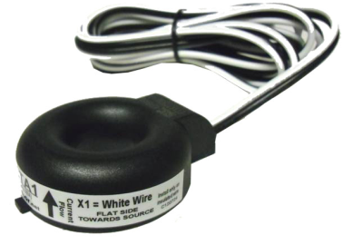
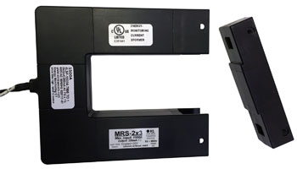
Current Transformers -- Types
Solid Core
  Must pass wire through the CT
  Requires shutdown / disconnect
  Typically higher accuracy
Split Core
  Does not require disconnect
  In theory can be installed on live conductors (caution!!)
  Typically lower accuracy
  Prone to more installation considerations (position, etc)
Output Types
  5A, mA, mV, Rogowski Coil
    (More on these later!)

Slide 15
Current Transformers
5A Output “Industry Standard”
Pros:
Industry “Standard”
Widely available
Wide variety of sizes and ratios (ie: 100:5A, 500:5A, 3000:5A)
Solid core and Split Core
Large Sizes (Physically)
Many mounting options
Lugs or wires
Low Cost (Solid Core)
Cons:
High cost (split core)
Large Size
Heavy
Requires shorting block
Limited options for small currents
Poor accuracy at small currents
Wire distance must be considered
Phase Shift!?

Slide 16
Current Transformer Types
Rogowski Coil
Pros:
Cost effective considering installation and current measurement size.
Easy to install
Space Saving
Linear
Accurate! (**)
Low Phase Shift (**)
Cons:
Poor Accuracy (**)
Positional Placement (**)
Magnetic Sensitivity (**)
Electrical Noise Sensitivity (**)
Not All Rogowski Coils
Are Created Equal

Slide 17
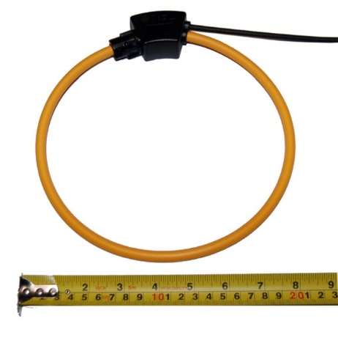
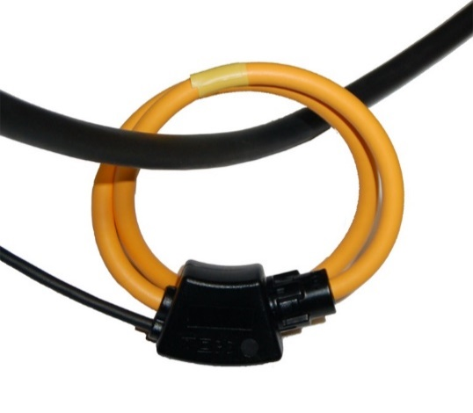
Current Transformer Types
Rogowski Coil: Elkor RC-600
Available as UL Listed model
Maximum lead length: 15m (~50ft)

Slide 18
Current Transformers
mA Output
Pros:
Low Cost
High Accuracy (esp. low current)
Smaller size
Do not need to specify full scale
Safe Outputs
Less part variations, easier to stock
Becoming a “new standard” (ie: 100:0.1A)
Longer wire runs accepted
Can use multiple CTs per phase
Cons:
Limited sizes for large currents (largest is 3x5”, 2500A)
Output not “standardized”
Requires –mA Meter Model (lower cost!)

Slide 19
WattsOn®-Mark II
Product Overview

Slide 20
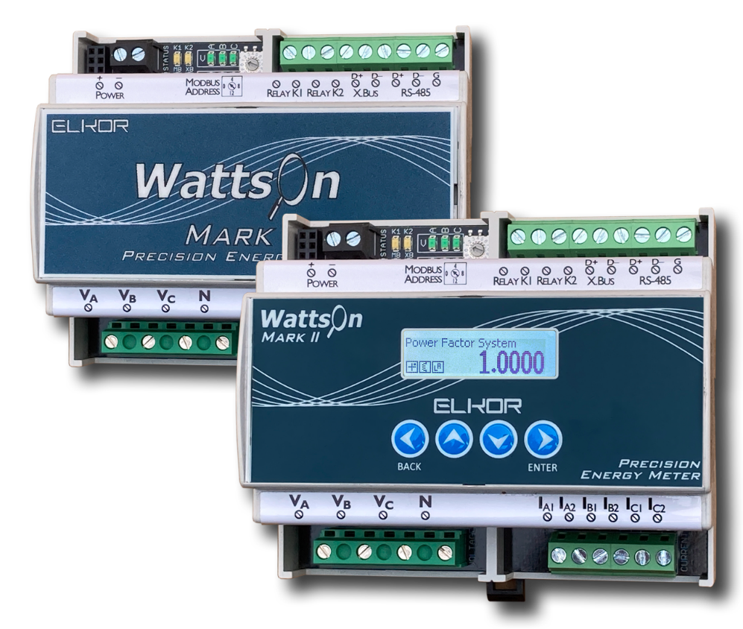
WattsOn-Mark II: Precision Energy Meter
ANSI C12.1/C12.20 Class 0.1 Four Quadrant
5A, mA, 333mV, Rogowski Coil CTs
Modbus (RTU/TCP), BACnet (MSTP / IP)
Highly configurable
Alarm / Pulse Outputs
Display with Datalogging & RTC
DIN Mount or Wall Mount
“Kit” Available

Slide 21
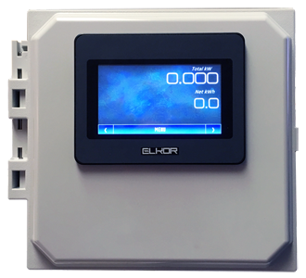
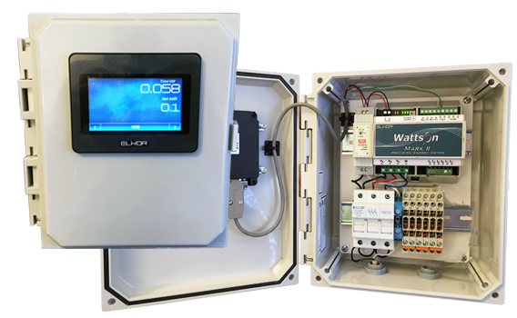
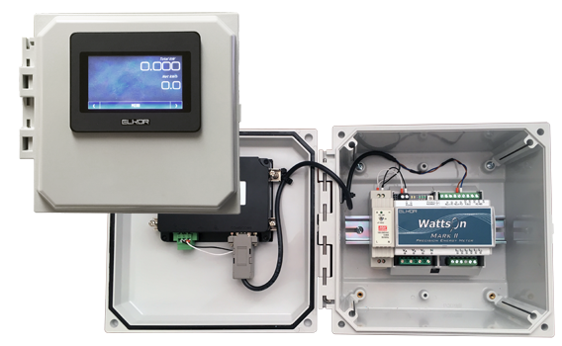
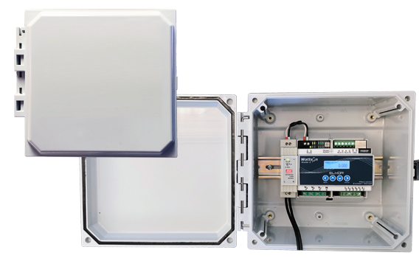
WattsOn-Mark II Kit: Precision Energy Meter Kit
Polycarbonate NEMA (4X Optional)
Power Supply / Touchscreen Prewired
Available with all meter configurations

Slide 22
WattsOn-Mark II: Accuracy
Newest generation digital metering technology.
Extremely high resolution, (24-bit A/D) and Ultra high dynamic range
ANSI C12.20 Class 0.2 Certified Accuracy
Meets & Exceeds ANSI C12.1 Class 0.1
Laboratory Grade metering standard accuracy
California CSI List of Eligible Metering Equipment (PBI)
Massachusetts SREC
Measurement Canada Approved

Slide 23
WattsOn-Mark II: Inputs
12-30V Power supply input (allows for universal application)
  48VDC power supply optional
Voltage measurement inputs 10 – 347Vac (Line-to-Neutral) (Up to 600V L-L)
Current input options:
  -5A: 5A Current Transformers (10A input max)
  -mV: 333mV Current Transformers
  -mA: 200mA for mA output Current Transformers
  -RC: Rogowski Coil (360mV / 3000A max)
  -RCH: Rogowski Coil (720mV / 6000A max)

Slide 24
WattsOn-Mark II: Outputs
RS-485 Modbus/RTU (-M1 Model)
  Highly configurable
  Flexible Modbus Map (can re-configure it freely)
  Flexible Baud Rates, Stop Bits, etc.
  SunSpec
Pulse / Alarm Outputs (All models)
  Two solid State Relay outputs
  Can configure as pulse outputs, or alarm outputs
  Very flexible field configuration
  Can trigger on any measured parameter
Ethernet/WiFi Features (-E4 Model or ETport)
  Integrated Real-Time Monitoring via web page
  Highly flexible HTTP POST with configurable posting templates
  Built-in Modbus/TCP
  Very flexible API

Slide 25
WattsOn-Mark II: Advanced Features
Password protection
CT Phase Compensation
Low PF Filtering
Sliding Window Calculations
Scratchpad for user configurations
Easy wiring with intuitive LEDs
Variety of wiring configurations (single, split, delta, wye)
Channel re-assignment (change voltage to current) **
Channel Reversal **
Sign (W/VAR/PF) selection **
Firmware upgradable

Slide 26
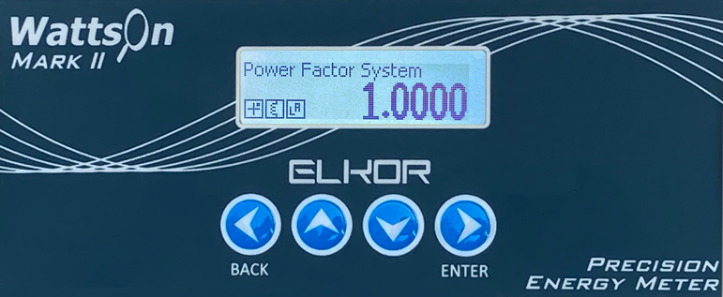
WattsOn-Mark II: Display
Optional Datalogging + Display (-DL)
  Intuitive graphic LCD
    Easy to read, no hieroglyphs!
    Easy to configure
  Built in RTC (battery backed)
  Built in FLASH storage for data-logging (flexible configuration for very long storage periods)

Slide 27
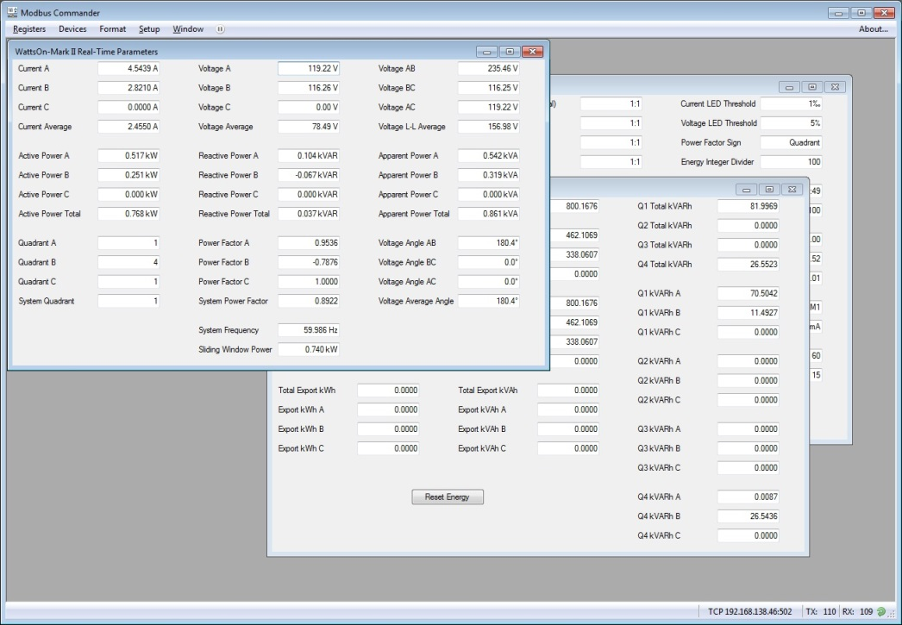
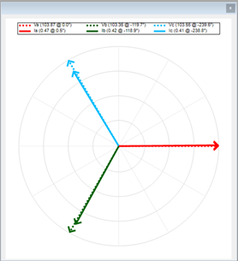
Modbus Commander
Designed for use with WattsOn, WattsOn-Mark II, i-Spy
Configure Device
Monitor Device
Configure Display
Datalogging
Phasor Diagrams
FREE

Slide 28
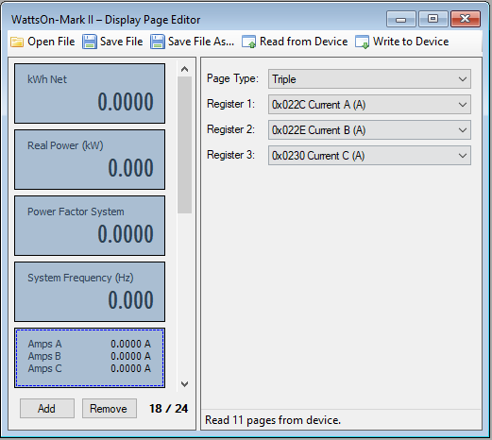
WattsOn-Mark II: Display
Display pages may be configured in Modbus Commander Software
Single / Triple parameter pages

Slide 29
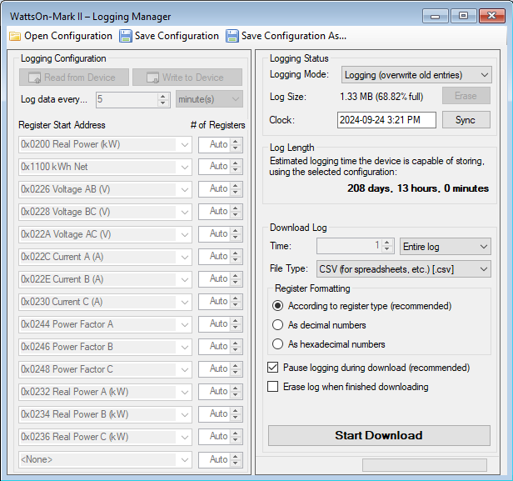
WattsOn-Mark II: Datalogging
Logging Configured Using Modbus Commander
NEW Simplified Interface
Log Length Calculator

Slide 30
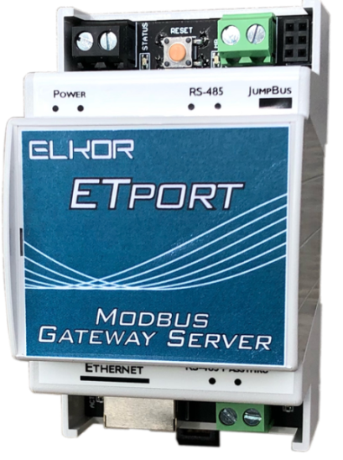
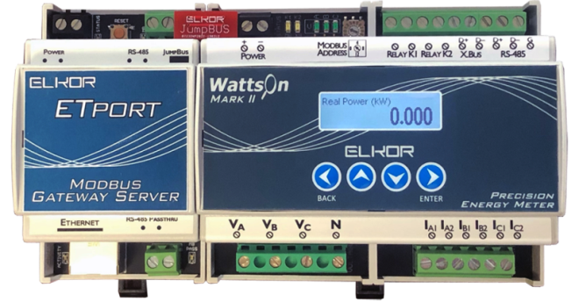
ETport
Adds Ethernet/WiFi capability to WattsOn-Mark II Meter
Works with multiple devices
Works as a generic Modbus/RTU <-> TCP gateway
On-board web server with user configurable registers
HTTP, MQTT, BACnet/IP, API Post capability
Passthrough port allows simultaneous Modbus/RTU access
Plug-n-Play installation

Slide 31
WattsOn-MCM
Multi Channel metering
Up to 60 circuits!

Slide 32
Installation Practices

Slide 33
Installation Practices
Fusing
Wiring Diagrams
CT Shorting Blocks
Current Transformers
RS-485

Slide 34



Voltage Inputs – Wiring Types
3-Phase
Wye
3-Phase
Delta
“Split” Phase
Single Phase
Notes:
Our company and products service multiple industries.
Within solar and renewable monitoring we offer:
Bi-Directional Revenue Metering, Performance Monitoring and Export limit solutions.
In Building energy management, we give facility operators data visibility through their DDC or controls systems. This allows for verification as well as branch or tenant submetering.
For Industrial Automation, our products add process monitoring, cost appropriation, plant automation through integration with SCADA system, load shedding and power factor correction capabilities.
We give OEM Equipment Manufacturers the ability to add value to their electrical products by providing built-in, high quality power and energy metering data.

Slide 35
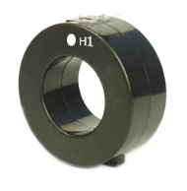
Voltage Wiring – Three Phase (WYE)
SOURCE
LOAD
A
A
B
B
C
N
C
Notes:
Our company and products service multiple industries.
Within solar and renewable monitoring we offer:
Bi-Directional Revenue Metering, Performance Monitoring and Export limit solutions.
In Building energy management, we give facility operators data visibility through their DDC or controls systems. This allows for verification as well as branch or tenant submetering.
For Industrial Automation, our products add process monitoring, cost appropriation, plant automation through integration with SCADA system, load shedding and power factor correction capabilities.
We give OEM Equipment Manufacturers the ability to add value to their electrical products by providing built-in, high quality power and energy metering data.

Slide 36
Voltage Wiring – Three Phase (Delta)
SOURCE
LOAD
A
B
A
B
C
N
C
Notes:
Our company and products service multiple industries.
Within solar and renewable monitoring we offer:
Bi-Directional Revenue Metering, Performance Monitoring and Export limit solutions.
In Building energy management, we give facility operators data visibility through their DDC or controls systems. This allows for verification as well as branch or tenant submetering.
For Industrial Automation, our products add process monitoring, cost appropriation, plant automation through integration with SCADA system, load shedding and power factor correction capabilities.
We give OEM Equipment Manufacturers the ability to add value to their electrical products by providing built-in, high quality power and energy metering data.

Slide 37
Voltage Wiring – Single Phase (“Split”)
SOURCE
LOAD
A
B
N
Notes:
Our company and products service multiple industries.
Within solar and renewable monitoring we offer:
Bi-Directional Revenue Metering, Performance Monitoring and Export limit solutions.
In Building energy management, we give facility operators data visibility through their DDC or controls systems. This allows for verification as well as branch or tenant submetering.
For Industrial Automation, our products add process monitoring, cost appropriation, plant automation through integration with SCADA system, load shedding and power factor correction capabilities.
We give OEM Equipment Manufacturers the ability to add value to their electrical products by providing built-in, high quality power and energy metering data.

Slide 38
Current Wiring – Single Phase (x3)
SOURCE
LOAD
A
N
Notes:
Our company and products service multiple industries.
Within solar and renewable monitoring we offer:
Bi-Directional Revenue Metering, Performance Monitoring and Export limit solutions.
In Building energy management, we give facility operators data visibility through their DDC or controls systems. This allows for verification as well as branch or tenant submetering.
For Industrial Automation, our products add process monitoring, cost appropriation, plant automation through integration with SCADA system, load shedding and power factor correction capabilities.
We give OEM Equipment Manufacturers the ability to add value to their electrical products by providing built-in, high quality power and energy metering data.

Slide 39
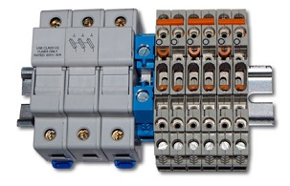
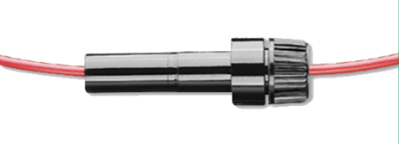
Fusing
Always follow electrical codes!
Reusing existing breakers
Fuses should be smallest possible.
  Consider system voltage requirements (ie: minimum ratings)
  ½ Amp fuses are practical
  Fusing is to protect the wiring to the meter
  Metering inputs are HIGH IMPEDANCE

Slide 40
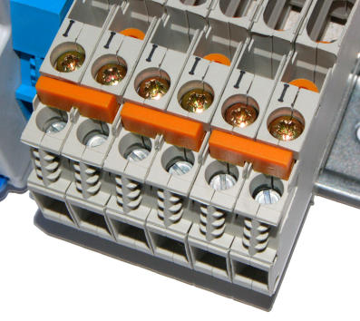
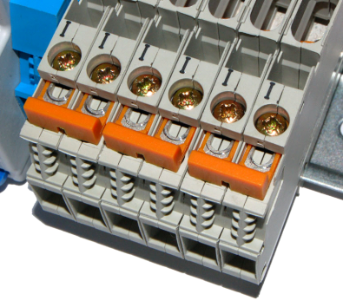
CT Shorting Blocks
Highly recommended (required) for 5A style CTs
Not Required for RC, mV or mA output CTs
V = IR !
Installation/Maintenance
Closed (Shorted) Position
Metering
Open Position

Slide 41
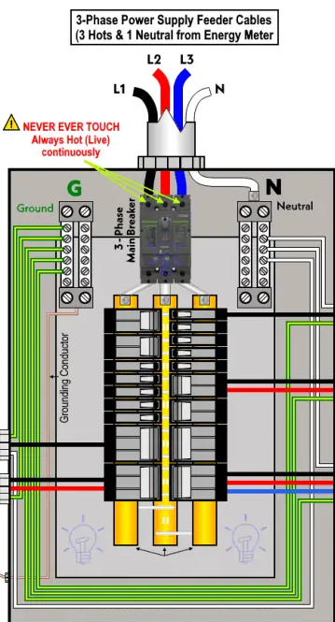
Voltage Inputs - Phases
Up to 600V (line-to-line) direct
PTs not required for voltages below 347/600V
Ensure NO live voltages when wiring into the meter!
Note breaker/phase relationship!
Notes:
Our company and products service multiple industries.
Within solar and renewable monitoring we offer:
Bi-Directional Revenue Metering, Performance Monitoring and Export limit solutions.
In Building energy management, we give facility operators data visibility through their DDC or controls systems. This allows for verification as well as branch or tenant submetering.
For Industrial Automation, our products add process monitoring, cost appropriation, plant automation through integration with SCADA system, load shedding and power factor correction capabilities.
We give OEM Equipment Manufacturers the ability to add value to their electrical products by providing built-in, high quality power and energy metering data.

Slide 42




Current Inputs – Current Transformers
4 Ps
POSITION
(ORIENTATION)
POLARITY
PHASING
PARING
Notes:
Our company and products service multiple industries.
Within solar and renewable monitoring we offer:
Bi-Directional Revenue Metering, Performance Monitoring and Export limit solutions.
In Building energy management, we give facility operators data visibility through their DDC or controls systems. This allows for verification as well as branch or tenant submetering.
For Industrial Automation, our products add process monitoring, cost appropriation, plant automation through integration with SCADA system, load shedding and power factor correction capabilities.
We give OEM Equipment Manufacturers the ability to add value to their electrical products by providing built-in, high quality power and energy metering data.

Slide 43
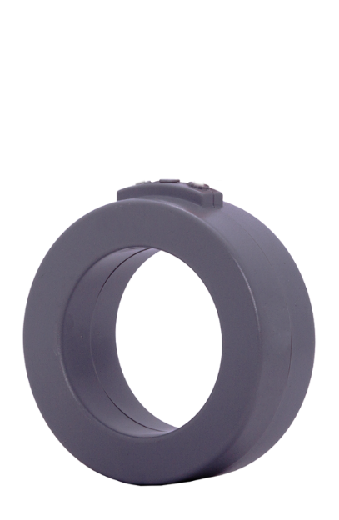
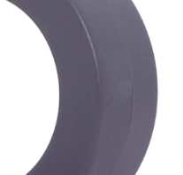
Current Inputs – CT Polarity
POLARITY
Reversing Polarity:
Does NOT change current readings
Does NOT change magnitude of power
Reverses sign of power (and power factor) and thereby direction of energy accumulation
X1
X2
SOURCE
LOAD
H1
Notes:
Our company and products service multiple industries.
Within solar and renewable monitoring we offer:
Bi-Directional Revenue Metering, Performance Monitoring and Export limit solutions.
In Building energy management, we give facility operators data visibility through their DDC or controls systems. This allows for verification as well as branch or tenant submetering.
For Industrial Automation, our products add process monitoring, cost appropriation, plant automation through integration with SCADA system, load shedding and power factor correction capabilities.
We give OEM Equipment Manufacturers the ability to add value to their electrical products by providing built-in, high quality power and energy metering data.

Slide 44
Current Inputs – CT Position
POSITION
(ORIENTATION)
Reversing Orientation:
Same as reversing polarity
Does NOT change current readings
Does NOT change magnitude of power
Reverses sign of power (and power factor)
and thereby direction of energy accumulation
X1
X2
SOURCE
LOAD
H1
Notes:
Our company and products service multiple industries.
Within solar and renewable monitoring we offer:
Bi-Directional Revenue Metering, Performance Monitoring and Export limit solutions.
In Building energy management, we give facility operators data visibility through their DDC or controls systems. This allows for verification as well as branch or tenant submetering.
For Industrial Automation, our products add process monitoring, cost appropriation, plant automation through integration with SCADA system, load shedding and power factor correction capabilities.
We give OEM Equipment Manufacturers the ability to add value to their electrical products by providing built-in, high quality power and energy metering data.

Slide 45

Current Wiring – CT Phasing
PHASING
Incorrect Phasing:
Erroneous power (and therefore energy)
Erroneous power factor (usually LOW)
A
B
C
SOURCE
LOAD
Notes:
Our company and products service multiple industries.
Within solar and renewable monitoring we offer:
Bi-Directional Revenue Metering, Performance Monitoring and Export limit solutions.
In Building energy management, we give facility operators data visibility through their DDC or controls systems. This allows for verification as well as branch or tenant submetering.
For Industrial Automation, our products add process monitoring, cost appropriation, plant automation through integration with SCADA system, load shedding and power factor correction capabilities.
We give OEM Equipment Manufacturers the ability to add value to their electrical products by providing built-in, high quality power and energy metering data.

Slide 46


Current Wiring – CT Pairing
PARING
Incorrect Paring:
No or Incorrect Current Readings
Incorrect Power/Energy
Possible meter damage!
A
B
C
A
A
B
A
B
C
C
SOURCE
LOAD
Notes:
Our company and products service multiple industries.
Within solar and renewable monitoring we offer:
Bi-Directional Revenue Metering, Performance Monitoring and Export limit solutions.
In Building energy management, we give facility operators data visibility through their DDC or controls systems. This allows for verification as well as branch or tenant submetering.
For Industrial Automation, our products add process monitoring, cost appropriation, plant automation through integration with SCADA system, load shedding and power factor correction capabilities.
We give OEM Equipment Manufacturers the ability to add value to their electrical products by providing built-in, high quality power and energy metering data.

Slide 47
Current Transformers -- Installation
Bus color coding
Wire color coding
Number of wires

Slide 48


CT – X2 Common / Grounding
ONLY applicable to 5A CTs / Meters

Slide 49
Current Transformers – Sharing CTs
ONLY applicable to 5A CTs / Meters

Slide 50
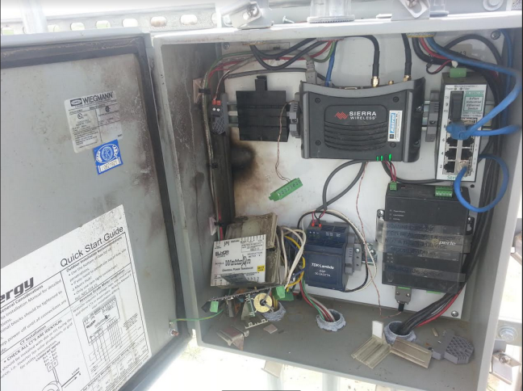
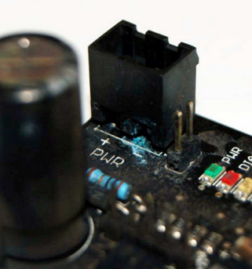
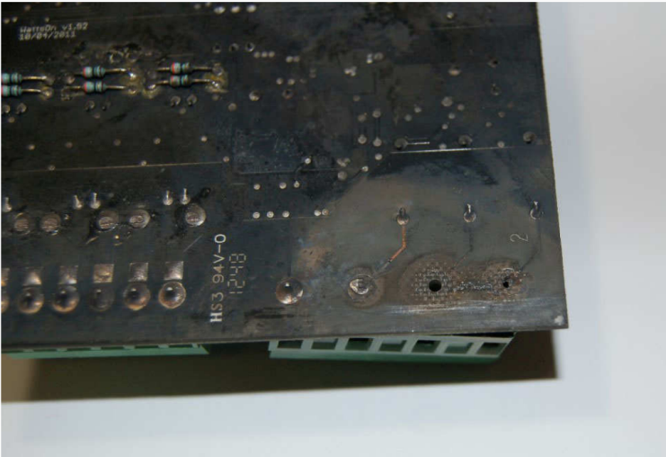
Installation Practices – Environmental Protection
WattsOn & WattsOn-Mark II must be environmentally protected
Rated for non-condensing
Ensure proper drainage!
Observe how conduits come in!

Slide 51
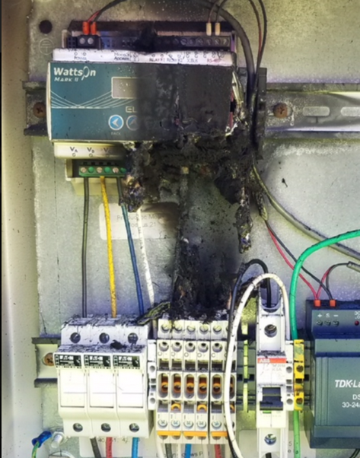
Installation Practices – CT Type
Ensure correct CT type is matched to the meter
5A CTs will destroy non 5A meters!

Slide 52

Installation Practices – RS-485
Ensure proper cabling (shielded, twisted pair)
Termination Resistors?
EMI / Surge Protection (WattsOn vs WattsOn-Mark II)
Ensure proper topology
Ensure proper grounding/shielding

Slide 53
Meter Configuration

Slide 54
Meter Configuration – PT Ratios
PTs required for voltages > 600/347V
When PTs are used, must enter PT Ratios for proper scaling
PT Ratios are used for any quantity involving Voltage (V, W, VA, VAR, Energy)
May be set in any integer ratios (240:120, 347:120, 600:120, 5:1, etc).
WattsOn-Mark II allows to set different PT ratios per channel if desired.
Default meter setting is 1:1!

Slide 55
Meter Configuration – CT Ratios
CT Ratios must (always) be entered
Display will prompt for CT ratios if not already set
Depending on type of CT used, ratio should be considered (5A, mA, mV, RC)
CT Type | CT Rating | WattsOn-Mark II
5A | 800:5 | 800 : 5
RC | 120mV @ 1000A | 1000 : 120

Slide 56

Meter Configuration – Modbus/RTU
Modbus Address (1-15) may be set via DIP switch
  Higher Modbus Addresses are available through software settings (or display)
LCD is the easiest way to change settings
Modbus/RTU may be configured for:
  Baud
  Parity
  Stop Bits
  Response Delay

Slide 57
Meter Configuration (Other)
All configuration can be done via Modbus writes
Modbus Commander
Most configuration can be done via on-board Display (if equipped)
Other configuration possibilities
  Password
  Sliding Window Demand Power
  LED Thresholds
  Power Factor Sign Mode
  Register Map Customization
  CT Phase Compensation
  “Compatibility” Mode (for original WattsOn)
  Advanced Configuration

Slide 58
Meter Configuration – (Re-commissioning FST)
FST used PT Ratio as placeholder for system type
Only integer registers were read (they did not consider PT/CT Ratios)
CT Ratios were never entered (they were calculated at the server)
Application Note AN1201 (internal)

Slide 59
Meter Configuration – Obvius Acquisuite (or TCP Gateway)
Can use Acquisuite as Modbus TCP – RTU Gateway
Can use Modbus Commander Software
Application Note available
PS: Obvius natively supports WattsOn-Mark II !

Slide 60
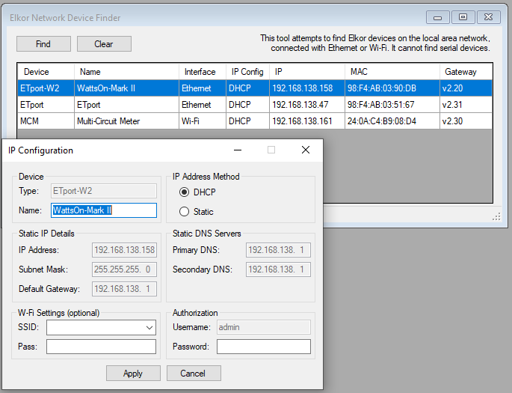
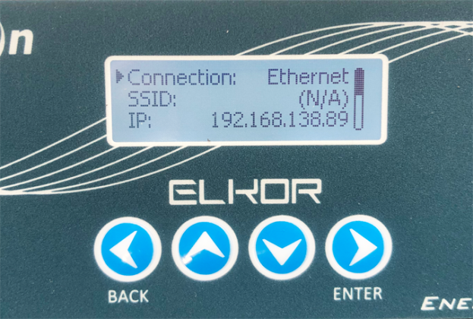
Meter Configuration – IP Address (E4 meters)
Default is DHCP
Current IP Address is shown on display (if equipped!)
IP address may be set using “Finder” within Modbus Commander
Tutorial Video Available

Slide 61
Troubleshooting

Slide 62
Troubleshooting
Functionality
Measurements

Slide 63
Troubleshooting Functionality

Slide 64
Troubleshooting - Functionality
1) Check STATUS LED
  Bi-Color LED (Red / Green)
A
LED | Meaning
 | Device is operating Normally
 | Meter is in bootloader mode (likely DIP address set to “zero”)
 | DIP set to zero (while powered). Used for debugging purposes (forces 9600bps) -- “Known Good Configuration”
 | Hardware Failure

Slide 65
Troubleshooting - Communications
Modbus LED
  Bi-Color LED (Red / Green)
A
LED | Meaning
 | Query Received / Response Sent
 | Query Received (No Response)

Slide 66
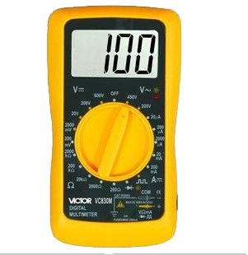
Troubleshooting – Modbus/RTU Communications
Confirmation resistance across Modbus/RTU ports:
D+ to D-
D+ to G
D- to G
> 100kΩ

Slide 67
Troubleshooting – RS-485 (Modbus /RTU) Settings
Use Display to view settings!
“Known Good Configuration”
Set DIP switch to “0” without powering off the meter
Serial settings are then fixed at 9600bps, N, 8, 1
Meter will reply on ANY address
Can read “Configuration” to view configured parameters

Slide 68
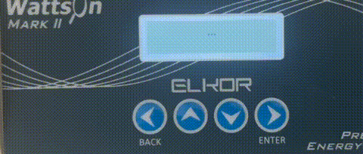
Troubleshooting – Display Bootlooping
Firmware Update
https://support.elkor.net

Slide 69
Troubleshooting Measurements

Slide 70
Measurement Troubleshooting - Voltage
1) Check VOLTAGE
  Per phase, Green Color
A
LED | Meaning
 | Voltage (> 5VAC) detected in phase
 | No Voltage Detected in Phase

Slide 71




Measurement Troubleshooting - Voltage
Is per-phase voltage reasonable?
Does phase-to-phase voltage make sense?
Is the voltage relatively uniform?
Voltage is ALWAYS positive
277.8
276.4
278.1
480.1
Notes:
Our company and products service multiple industries.
Within solar and renewable monitoring we offer:
Bi-Directional Revenue Metering, Performance Monitoring and Export limit solutions.
In Building energy management, we give facility operators data visibility through their DDC or controls systems. This allows for verification as well as branch or tenant submetering.
For Industrial Automation, our products add process monitoring, cost appropriation, plant automation through integration with SCADA system, load shedding and power factor correction capabilities.
We give OEM Equipment Manufacturers the ability to add value to their electrical products by providing built-in, high quality power and energy metering data.

Slide 72
Measurement Troubleshooting - Current
2) Check CURRENT
  Per Phase Bi-Color LED (Red / Green)
  Off if input is below 0.1% of full scale
  (~ 5mA on a 5A meter)
A
LED | Meaning
 | Power is positive (“imported”)
 | Power is negative (“exported”)
 | Power is positive (“imported”), but VAR > W (bad power factor). Potential CT Phasing issue.
 | Power is negative (“exported”), but VAR > W (bad power factor). Potential CT Phasing issue.

Slide 73
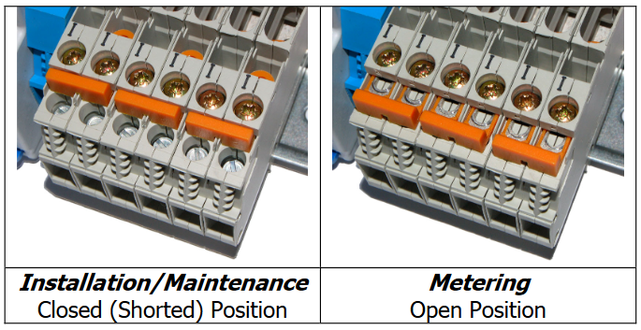
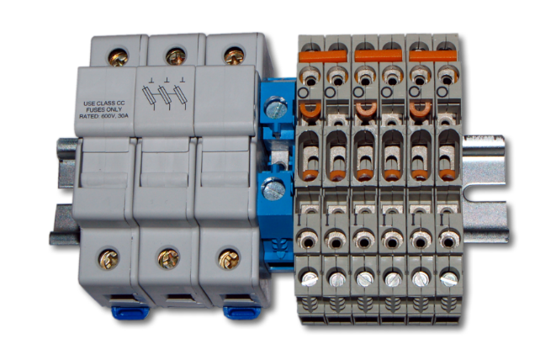

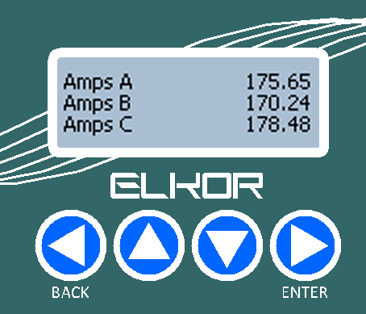
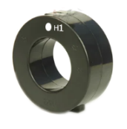
Measurement Troubleshooting - Current
Is per-phase current reasonable?
Have the CT ratios been set?
Is the current roughly uniform?
Current is ALWAYS positive
A
B
C
175.7
LOAD
Notes:
Our company and products service multiple industries.
Within solar and renewable monitoring we offer:
Bi-Directional Revenue Metering, Performance Monitoring and Export limit solutions.
In Building energy management, we give facility operators data visibility through their DDC or controls systems. This allows for verification as well as branch or tenant submetering.
For Industrial Automation, our products add process monitoring, cost appropriation, plant automation through integration with SCADA system, load shedding and power factor correction capabilities.
We give OEM Equipment Manufacturers the ability to add value to their electrical products by providing built-in, high quality power and energy metering data.

Slide 74



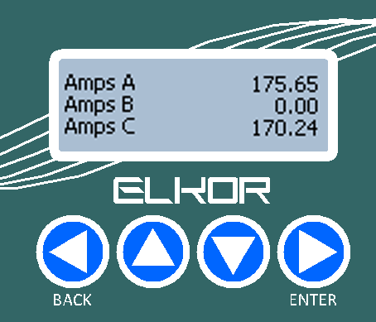
Measurement Troubleshooting – Current
A
B
C
Notes:
Our company and products service multiple industries.
Within solar and renewable monitoring we offer:
Bi-Directional Revenue Metering, Performance Monitoring and Export limit solutions.
In Building energy management, we give facility operators data visibility through their DDC or controls systems. This allows for verification as well as branch or tenant submetering.
For Industrial Automation, our products add process monitoring, cost appropriation, plant automation through integration with SCADA system, load shedding and power factor correction capabilities.
We give OEM Equipment Manufacturers the ability to add value to their electrical products by providing built-in, high quality power and energy metering data.

Slide 75
Measurement Troubleshooting – Current
A
B
C
Ensure CTs are wired properly after the test
Notes:
Our company and products service multiple industries.
Within solar and renewable monitoring we offer:
Bi-Directional Revenue Metering, Performance Monitoring and Export limit solutions.
In Building energy management, we give facility operators data visibility through their DDC or controls systems. This allows for verification as well as branch or tenant submetering.
For Industrial Automation, our products add process monitoring, cost appropriation, plant automation through integration with SCADA system, load shedding and power factor correction capabilities.
We give OEM Equipment Manufacturers the ability to add value to their electrical products by providing built-in, high quality power and energy metering data.

Slide 76
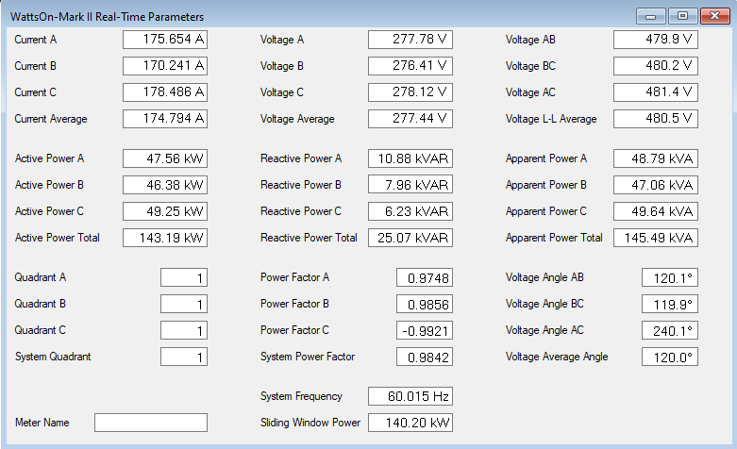
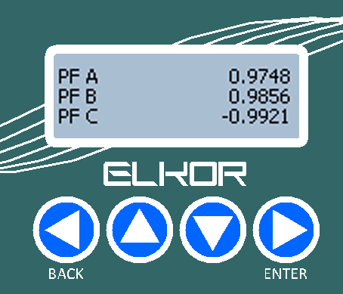
Measurements – Power Factor
Notes:
Our company and products service multiple industries.
Within solar and renewable monitoring we offer:
Bi-Directional Revenue Metering, Performance Monitoring and Export limit solutions.
In Building energy management, we give facility operators data visibility through their DDC or controls systems. This allows for verification as well as branch or tenant submetering.
For Industrial Automation, our products add process monitoring, cost appropriation, plant automation through integration with SCADA system, load shedding and power factor correction capabilities.
We give OEM Equipment Manufacturers the ability to add value to their electrical products by providing built-in, high quality power and energy metering data.

Slide 77
Measurement Troubleshooting – Power Factor
3) Check POWER FACTOR
  Per Phase Bi-Color LED (Red / Green)
  Flashing or Solid RED indicates
  Poor Power Factor
A
LED | Meaning
 | Power is positive (“imported”), but VAR > W (bad power factor). Potential CT Phasing issue.
 | Power is negative (“exported”), but VAR > W (bad power factor). Potential CT Phasing issue.

Slide 78
Measurements – Power Factor
0.9 < |PF| < 1.0
abs(Power Factor) should be between 0.9-1.0
Ignore the sign when validating power factor
Notes:
Our company and products service multiple industries.
Within solar and renewable monitoring we offer:
Bi-Directional Revenue Metering, Performance Monitoring and Export limit solutions.
In Building energy management, we give facility operators data visibility through their DDC or controls systems. This allows for verification as well as branch or tenant submetering.
For Industrial Automation, our products add process monitoring, cost appropriation, plant automation through integration with SCADA system, load shedding and power factor correction capabilities.
We give OEM Equipment Manufacturers the ability to add value to their electrical products by providing built-in, high quality power and energy metering data.

Slide 79
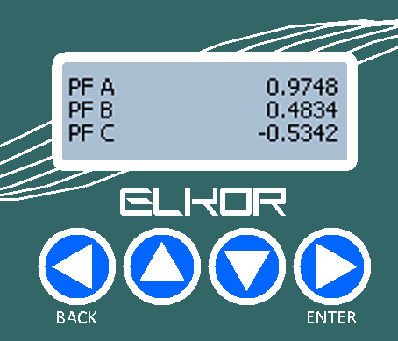

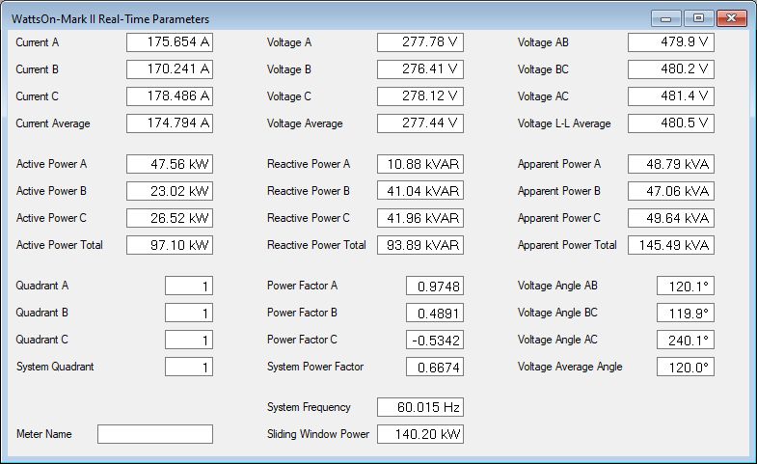
Measurements – Power Factor
0.7 < PF < 0.9
Below |0.75| should be questioned
Power Factor should be uniform
Remember: +0.99 and -0.99 is almost the same! (Power Factor pivots at “1”)
Generally, negative (ie: capacitive) power factors are rare (but not impossible).
Power factor can be deceiving at very small loads/currents
Notes:
Our company and products service multiple industries.
Within solar and renewable monitoring we offer:
Bi-Directional Revenue Metering, Performance Monitoring and Export limit solutions.
In Building energy management, we give facility operators data visibility through their DDC or controls systems. This allows for verification as well as branch or tenant submetering.
For Industrial Automation, our products add process monitoring, cost appropriation, plant automation through integration with SCADA system, load shedding and power factor correction capabilities.
We give OEM Equipment Manufacturers the ability to add value to their electrical products by providing built-in, high quality power and energy metering data.

Slide 80
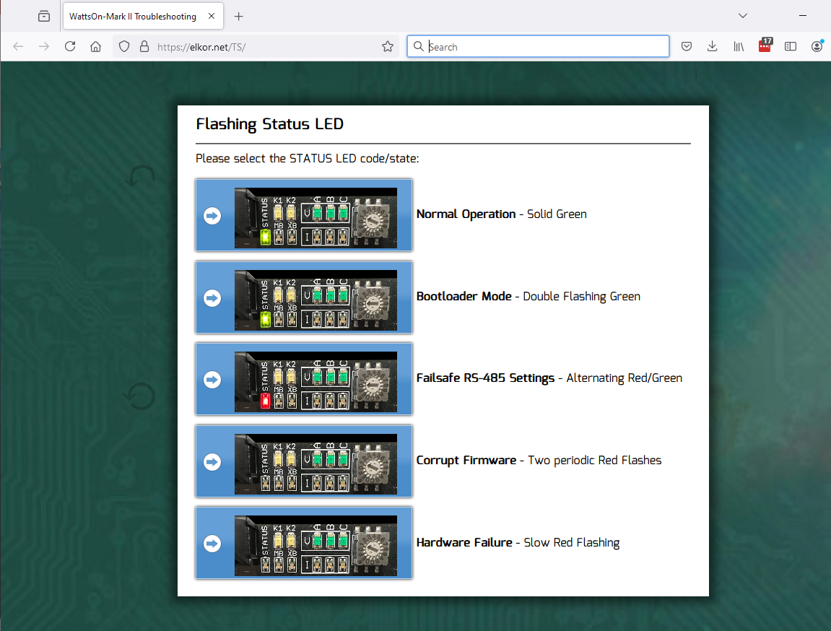
Troubleshooting – Interactive Troubleshooting
https://elkor.net/TS

Slide 81

Troubleshooting – Phasor Diagrams
Ideal Power Factors

Slide 82

Troubleshooting – Phasor Diagrams
Typical Installation (PF ~ 0.9)

Slide 83

Troubleshooting – Phasor Diagrams
CT “A” Reversed!

Slide 84

Troubleshooting – Phasor Diagrams
CT “B” & CT “C” Swapped!

Slide 85

Troubleshooting – Phasor Diagrams
Fixed by swapping voltages

Slide 86

Troubleshooting – Phase Calculator
http://www.elkor.net/phase_calc

Slide 87


Troubleshooting – Unexpected Accumulation
AN1601 - Effect of Current Transformer Phase Shift On Metering Accuracy

Slide 88
Maintenance
Recertification Period:
Elkor recommends a re-certification period of 5 years.
Requirement ultimately depends on the client, application, jurisdiction, project.
Three Options:
  Remove and send the unit to the factory.
  Purchase another meter to swap out in rotation.
  Do an in-field audit of the meter.

Slide 89

Client Portal
http://client.elkor.net

Slide 90

Support / Knowledgebase
https://support.elkor.net

Slide 91
Thank You!

Slide 92

Meter Configuration – Using RS-485 Cable
Need to use software (ie: Modbus Commander)
Need a Windows Based PC with RS-485 Cable
Recommend FTDI “Smart Cable”
  USB-RS485-WE-1800-BT
Application Note Available
Video available

Slide 93
Troubleshooting
WattsOn or WattsOn-Mark II
Functionality (ie: Communication, power-up)
or
Measurement (ie: “bad” data)

Slide 94
Troubleshooting – Flowchart

Slide 95
Introduction
Elkor Technologies Inc.
WattsOn Meter History

Slide 96

Power Theory – RMS
What are “RMS” measurements?
  Stands for “root-mean-square”
  It is the “DC equivalent”
  Important for voltage and current measurements
  It is how we can have a single measurement for a alternating (AC) quantity.

Slide 97

Power & Energy -- Quadrants

Slide 98
WattsOn-Mark II: Registers
Real Time
  Integer
  Floating Point
Energy -- Resettable
  Integer
  Floating Point
Energy -- Non-Resettable (“Revenue”)
  Integer
  Floating Point
Configuration
  Settings, Modbus, Relays, Configurable Register Map, Scratchpad

Slide 99
Current Transformer Types
333mV Output
Pros:
“Universal” Output
Safe Outputs
Variety of sizes
Cost (potentially)
Cons:
Susceptible to noise
Lower accuracy
Poor phase shift
Fixed ranges
Not really a “Standard”, each manufacturer has different specifications
Low voltage means resistance plays a factor

Slide 100
Current Transformer Types
mA Output
Pros:
Low Cost
High Accuracy (esp. low current)
Smaller size
Do not need to specify full scale
Safe Outputs
Less part variations, easier to stock
Becoming a “new standard” (ie: 100:0.1A)
Longer wire runs accepted
Can use multiple CTs per phase
Cons:
Limited sizes for large currents
Output not “standardized”
Requires precision meter ;)

Slide 101
mA and RC Input Models
Because the new WattsOn-Mark II has such a high resolution and wide dynamic range, it is no longer necessary to specify the CT full scale, or be forced to choose the CT.
First in the industry:
  Choose the meter
  Then Choose the CT physical size that fits the application
  WattsOn-Mark II flexible configuration even allows different CT ratios on each channel.

